Slide 1
Project - Sales Outlets' Performance

Slide 2
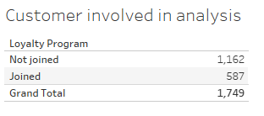
Highlights of the dashboard
Around 1/3 of the customers joined the loyalty program.

Slide 3
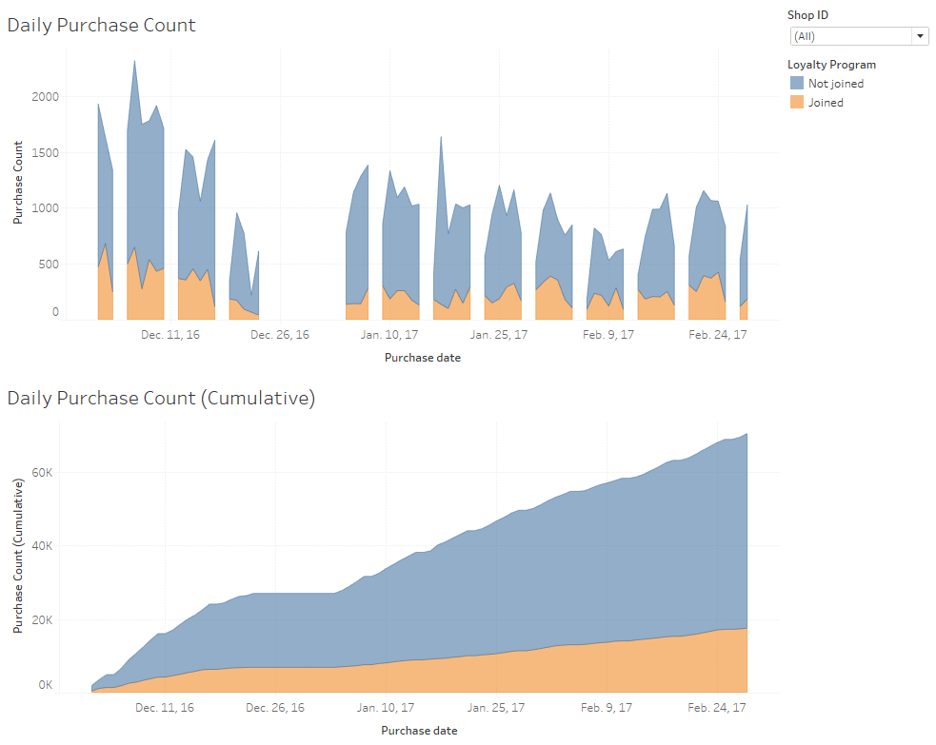
Highlights of the dashboard (con’t)
Customers who did not join the loyalty program purchased more items over loyalty customer.
Season effect – Overall more items were purchased before Christmas over the period afterwards

Slide 4
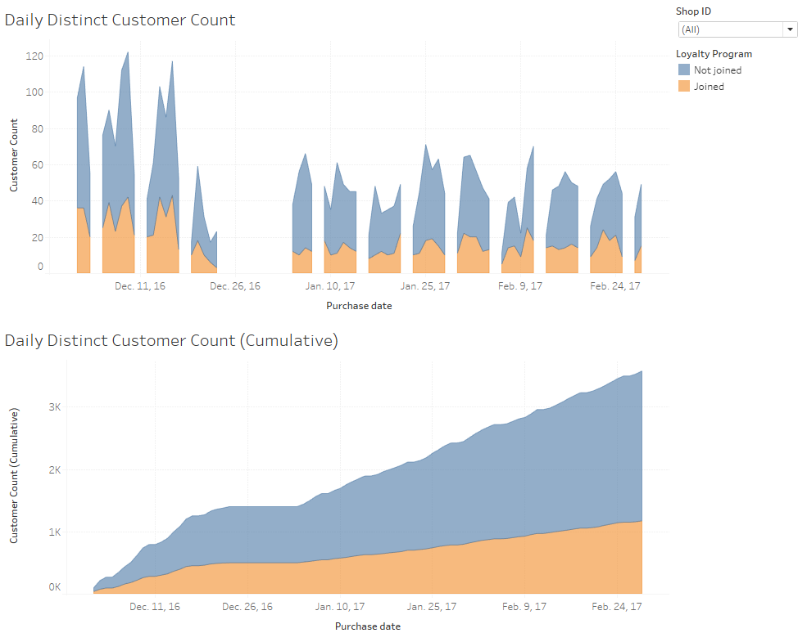
Highlights of the dashboard (con’t)
More non-loyalty program customers purchased over loyalty customer.

Slide 5
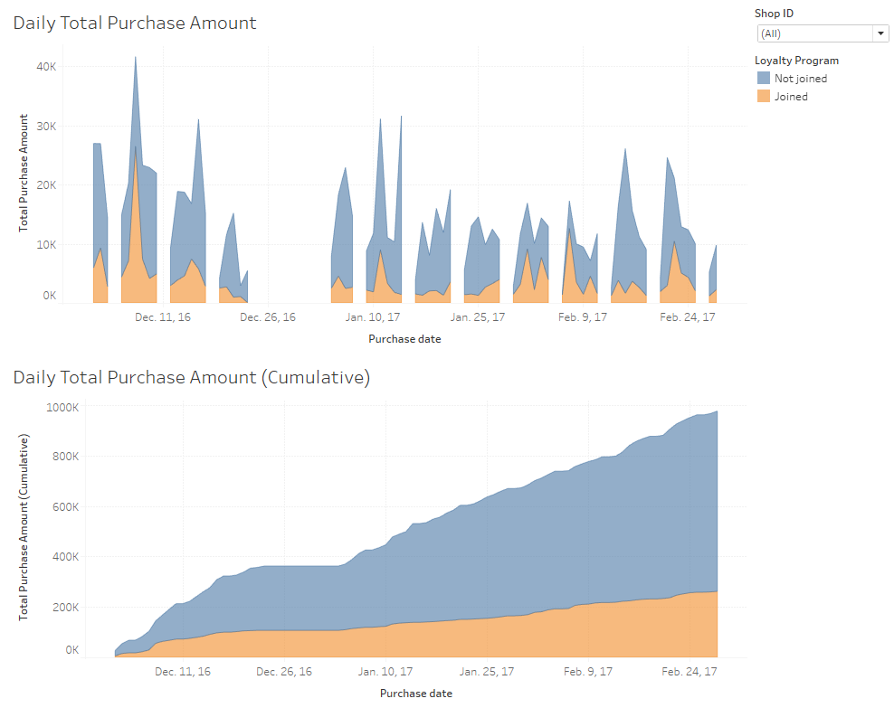
Highlights of the dashboard (con’t)
Non-loyalty program customers purchased higher amount over loyalty customer.

Slide 6
Conclusion
Customer joining the loyalty program purchased less in terms of amount and frequency.
One of the suggestion to improve is to offer loyalty customer exclusive promotion and rewards points campaign to promote frequent purchase.

Slide 7
Recommendation
More customer demographics should be included in the analysis to increase the effectiveness of the loyalty program.
Promotion method can also be part of the analysis to investigate how it can be improved.
Data of longer timeframe should be collected for better analysis to avoid bias due to seasonal effect.

